Slide 1
SOA Exam FM
Module 3 – Section 1
Loan Notation and Terminology

Slide 2
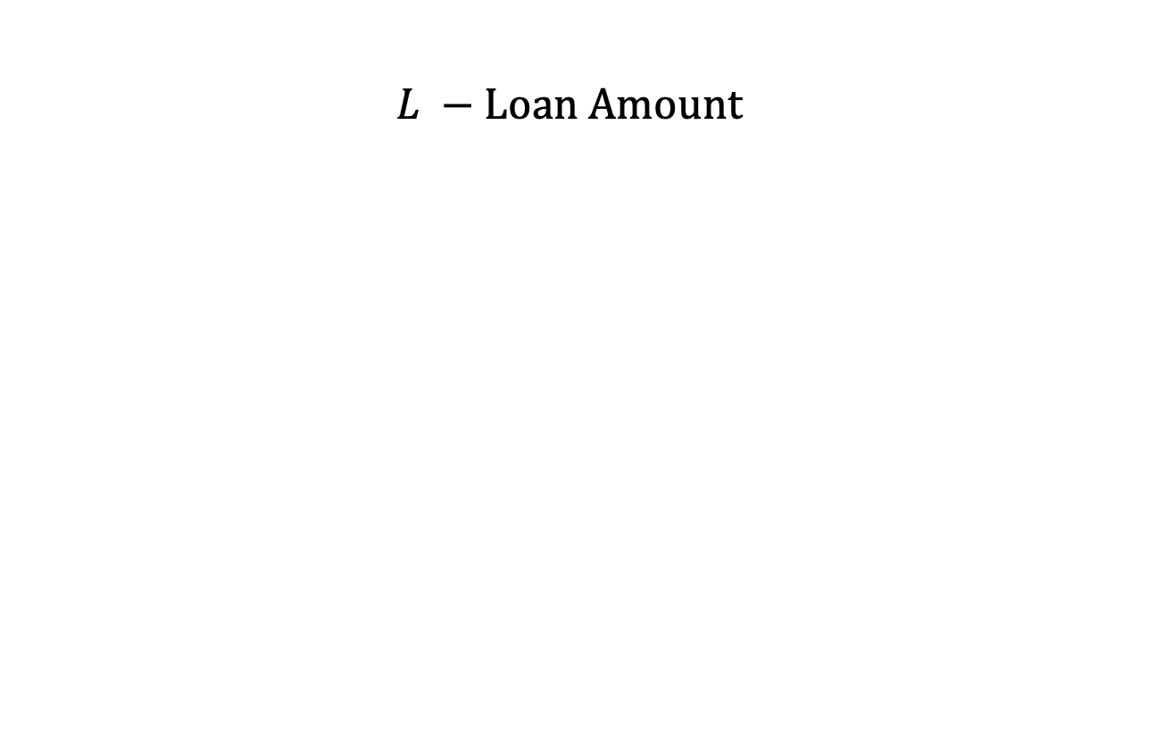
Notation and Terminology
$$L −Loan Amount$$

Slide 3
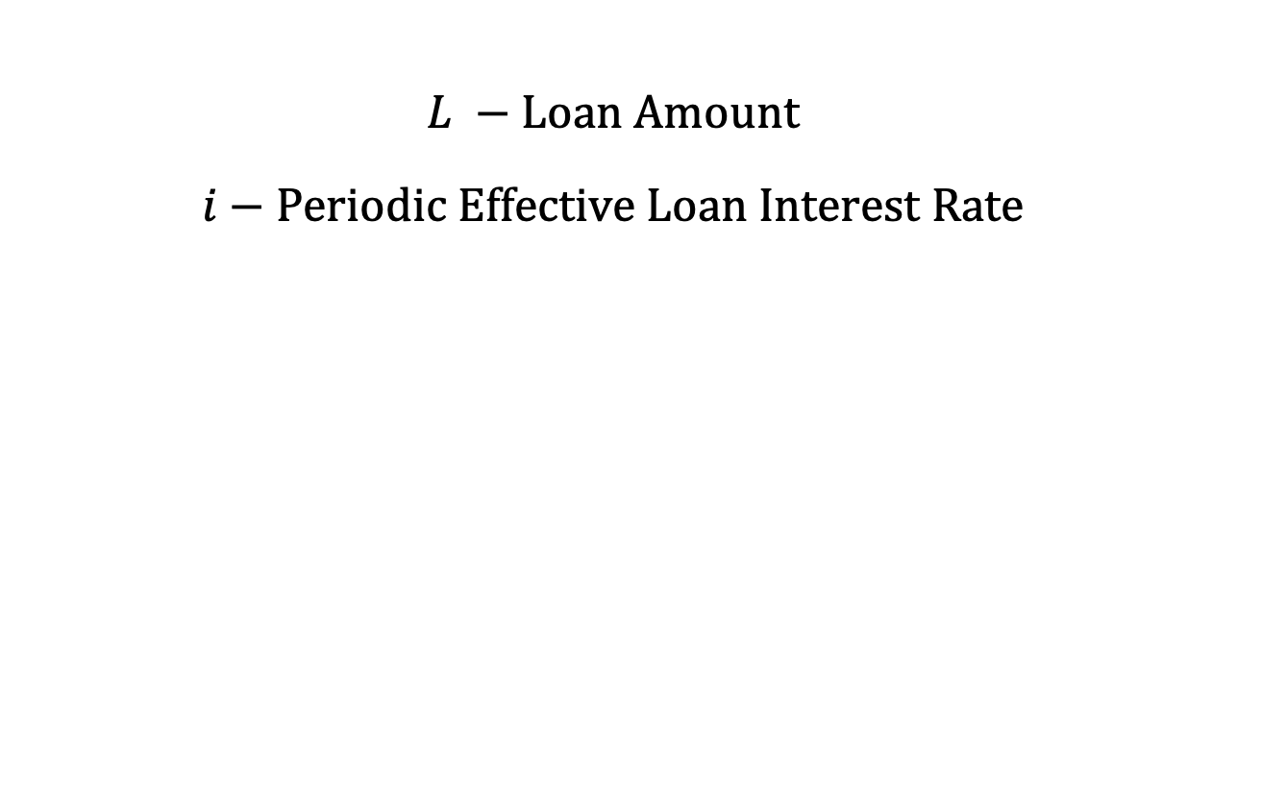
Notation and Terminology
$$L −Loan Amount$$
$$i−Periodic Effective Loan Interest Rate$$

Slide 4
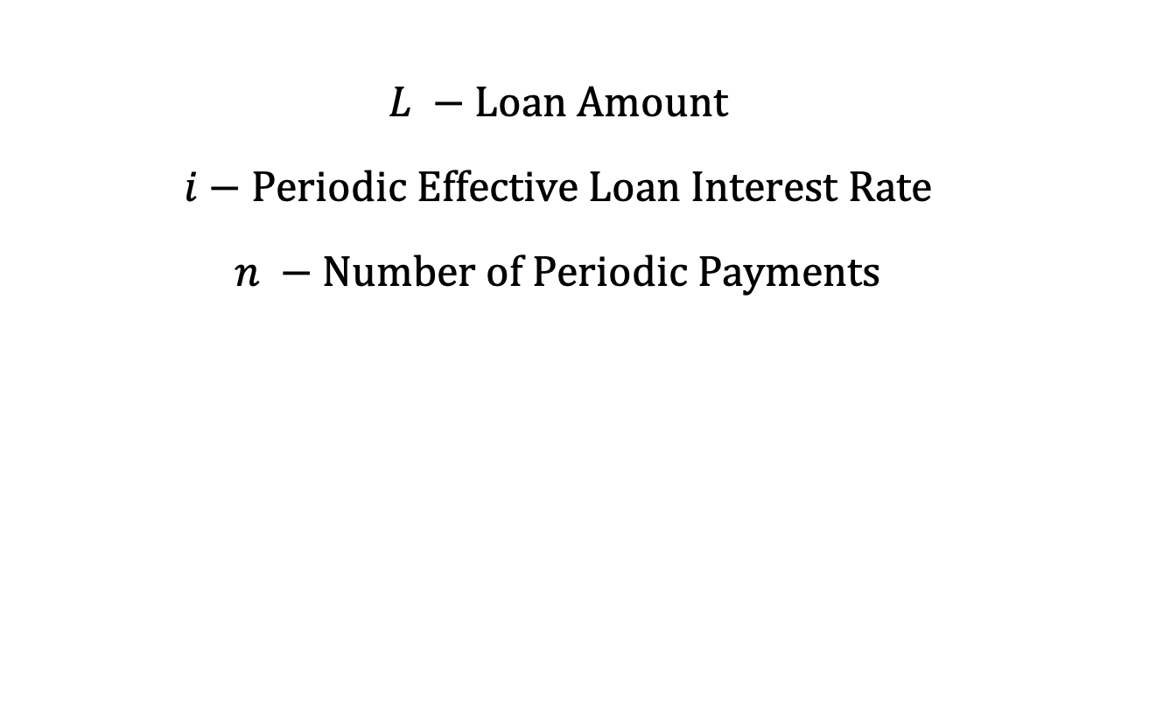
Notation and Terminology
$$L −Loan Amount$$
$$i−Periodic Effective Loan Interest Rate$$
$$n −Number of Periodic Payments$$

Slide 5
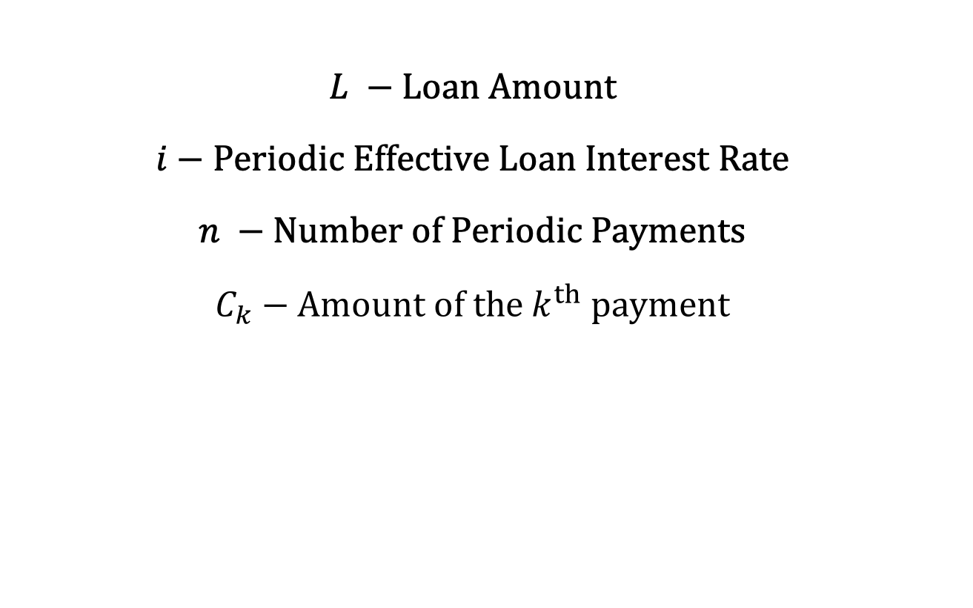
Notation and Terminology
$$L −Loan Amount$$
$$i−Periodic Effective Loan Interest Rate$$
$$n −Number of Periodic Payments$$
$$C_{k}−Amount of the k^{th} payment$$
Notes:
discuss “installments”

Slide 6
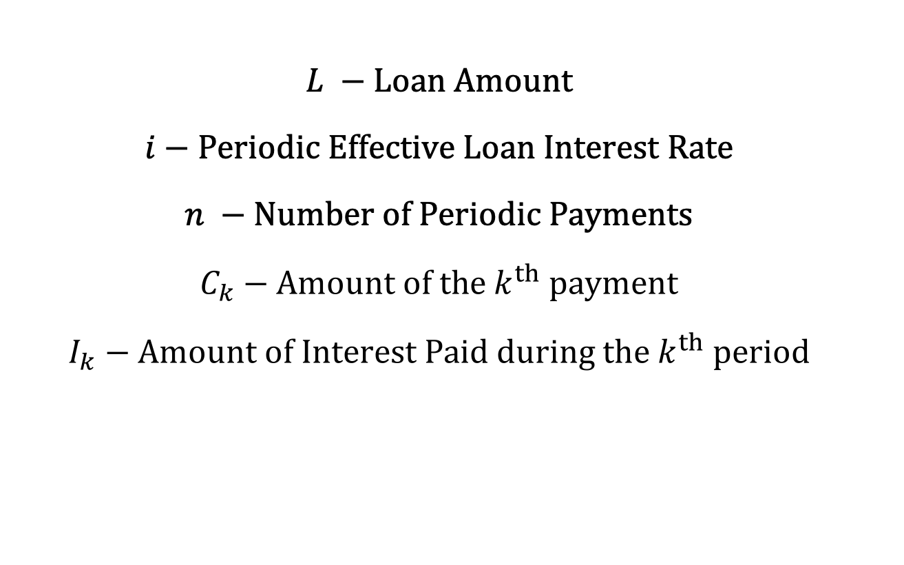
Notation and Terminology
$$L −Loan Amount$$
$$i−Periodic Effective Loan Interest Rate$$
$$n −Number of Periodic Payments$$
$$C_{k}−Amount of the k^{th} payment$$
$$I_{k}−Amount of Interest Paid during the k^{th} period$$

Slide 7
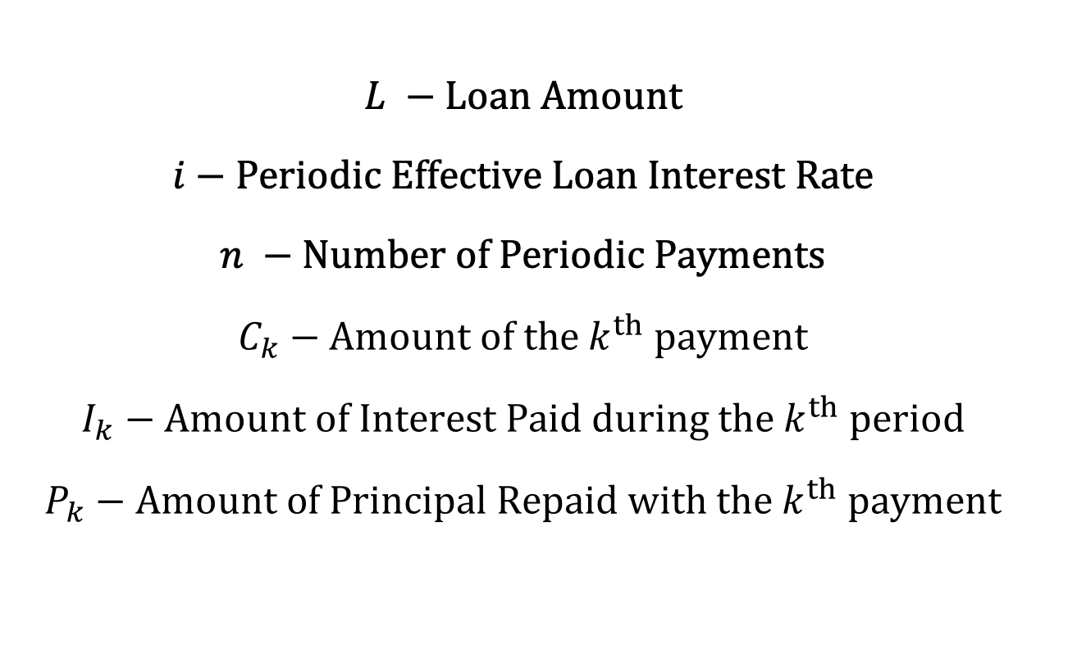
Notation and Terminology
$$L −Loan Amount$$
$$i−Periodic Effective Loan Interest Rate$$
$$n −Number of Periodic Payments$$
$$C_{k}−Amount of the k^{th} payment$$
$$I_{k}−Amount of Interest Paid during the k^{th} period$$
$$P_{k}−Amount of Principal Repaid with the k^{th} payment$$

Slide 8
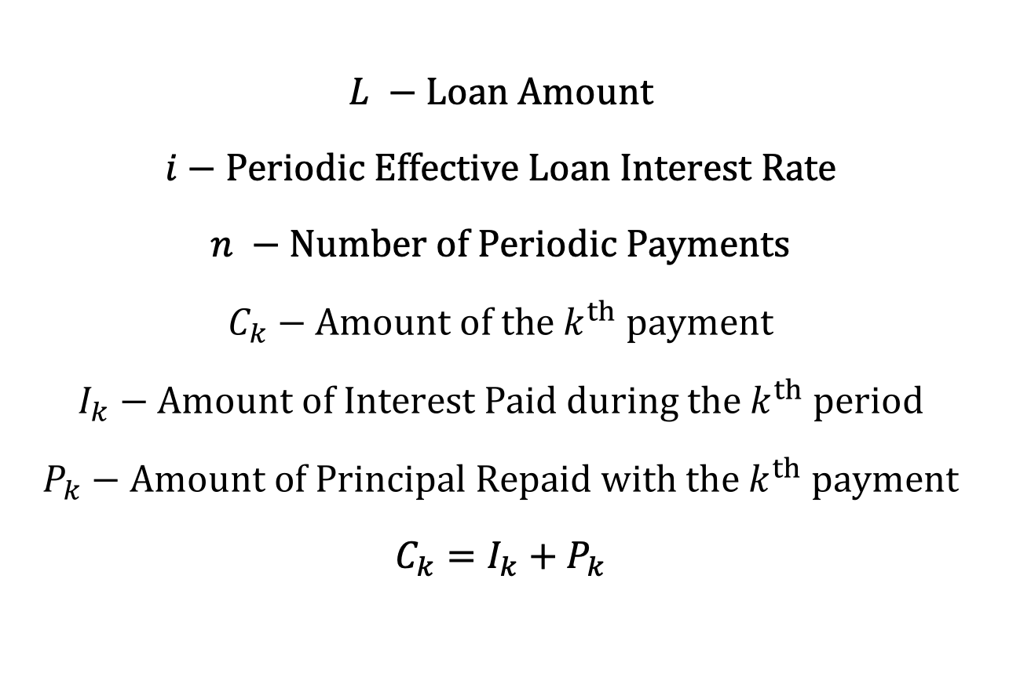
Notation and Terminology
$$L −Loan Amount$$
$$i−Periodic Effective Loan Interest Rate$$
$$n −Number of Periodic Payments$$
$$C_{k}−Amount of the k^{th} payment$$
$$I_{k}−Amount of Interest Paid during the k^{th} period$$
$$P_{k}−Amount of Principal Repaid with the k^{th} payment$$
$$C_{k}=I_{k}+P_{k}$$

Slide 9
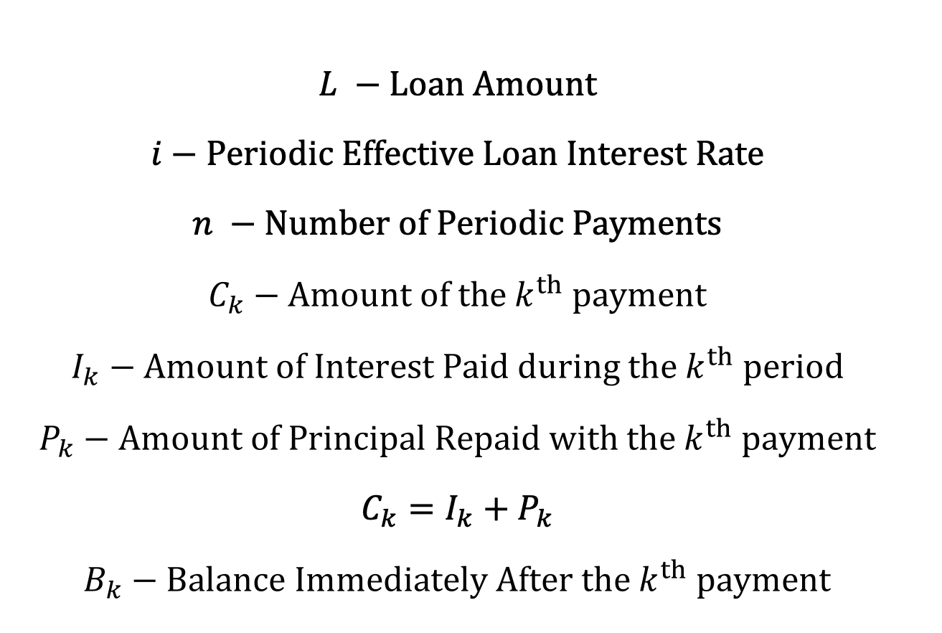
Notation and Terminology
$$L −Loan Amount$$
$$i−Periodic Effective Loan Interest Rate$$
$$n −Number of Periodic Payments$$
$$C_{k}−Amount of the k^{th} payment$$
$$I_{k}−Amount of Interest Paid during the k^{th} period$$
$$P_{k}−Amount of Principal Repaid with the k^{th} payment$$
$$C_{k}=I_{k}+P_{k}$$
$$B_{k}−Balance Immediately After the k^{th} payment$$
Notes:
discuss “outstanding balance” – call it the loan balance in the slide (or just the balance), “outstanding principal”

Slide 10






Timeline
$$C_{1}$$
$$C_{2}$$
$$⋯$$
$$C_{n}$$
$$L$$
$$=loan amount$$

Slide 11



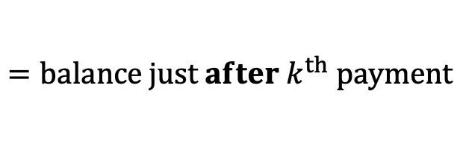
Timeline
$$C_{1}$$
$$C_{2}$$
$$⋯$$
$$C_{k}$$
$$⋯$$
$$L$$
$$=loan amount$$
$$B_{k}$$
$$=balance just after k^{th} payment$$

Slide 12

Timeline
$$C_{1}$$
$$C_{2}$$
$$⋯$$
$$C_{n}$$
$$L$$
$$=loan amount$$
$$B_{n}=0$$

Slide 13

Timeline
$$C_{1}$$
$$C_{2}$$
$$⋯$$
$$C_{n}$$
$$L$$
$$=loan amount$$
$$=B_{0}$$
$$B_{n}=0$$

Slide 14
Timeline
$$C_{1}$$
$$C_{2}$$
$$⋯$$
$$C_{k}$$
$$⋯$$
$$L$$
$$=loan amount$$
$$B_{k}$$
$$=balance just after k^{th} payment$$

Slide 15
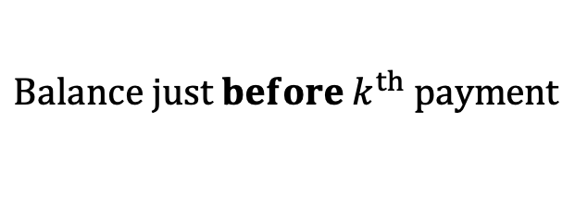
Timeline
$$C_{1}$$
$$C_{2}$$
$$⋯$$
$$C_{k}$$
$$⋯$$
$$L$$
$$=loan amount$$
$$B_{k}$$
$$=balance just after k^{th} payment$$
$$Balance just before k^{th} payment$$

Slide 16

Timeline
$$C_{1}$$
$$C_{2}$$
$$⋯$$
$$C_{k}$$
$$⋯$$
$$L$$
$$=loan amount$$
$$B_{k}$$
$$=balance just after k^{th} payment$$
$$Balance just before k^{th} payment$$
$$=B_{k}^{bef}$$

Slide 17

Timeline
$$C_{1}$$
$$C_{2}$$
$$⋯$$
$$C_{k}$$
$$⋯$$
$$L$$
$$=loan amount$$
$$B_{k}$$
$$=balance just after k^{th} payment$$
$$Balance just before k^{th} payment$$
$$=B_{k}^{bef}$$
$$B_{k}^{bef}−C_{k}=B_{k}$$

Slide 18

Timeline
$$C_{1}$$
$$C_{2}$$
$$⋯$$
$$C_{k}$$
$$⋯$$
$$L$$
$$=loan amount$$
$$B_{k}$$
$$=balance just after k^{th} payment$$
$$Balance just before k^{th} payment$$
$$=B_{k}^{bef}$$
$$B_{k}^{bef}−C_{k}=B_{k}$$
$$⇒ B_{k}^{bef}=B_{k}+C_{k}$$

Slide 19
Timeline
$$C_{1}$$
$$C_{2}$$
$$⋯$$
$$C_{k}$$
$$⋯$$
$$L$$
$$=loan amount$$
$$B_{k}$$
$$=balance just after k^{th} payment$$

Slide 20

Timeline
$$C_{1}$$
$$C_{2}$$
$$⋯$$
$$C_{k−1}$$
$$C_{k}$$
$$⋯$$
$$L$$
$$=loan amount$$
$$B_{k}$$
$$=balance just after k^{th} payment$$

Slide 21
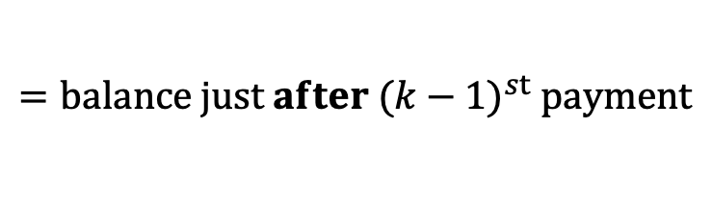

Timeline
$$C_{1}$$
$$C_{2}$$
$$⋯$$
$$C_{k−1}$$
$$C_{k}$$
$$⋯$$
$$L$$
$$=loan amount$$
$$B_{k}$$
$$=balance just after k^{th} payment$$
$$B_{k−1}$$
$$=balance just after {(k−1)}^{st} payment$$

Slide 22

Timeline
$$C_{1}$$
$$C_{2}$$
$$⋯$$
$$C_{k−1}$$
$$C_{k}$$
$$⋯$$
$$L$$
$$=loan amount$$
$$B_{k}$$
$$=balance just after k^{th} payment$$
$$B_{k−1}$$
$$=balance just after {(k−1)}^{st} payment$$
$$B_{k}^{bef}=B_{k−1}∙\left(1+i\right)$$

Slide 23

Timeline
$$C_{1}$$
$$C_{2}$$
$$⋯$$
$$C_{k−1}$$
$$C_{k}$$
$$⋯$$
$$L$$
$$=loan amount$$
$$B_{k}$$
$$=balance just after k^{th} payment$$
$$B_{k−1}$$
$$=balance just after {(k−1)}^{st} payment$$
$$B_{k}^{bef}=B_{k−1}∙\left(1+i\right)$$
$$B_{k}^{bef}=B_{k}+C_{k}$$

